Slide 1
Web Development
CSE343
Lab 3

Slide 2
JavaScript

Slide 3

Why use JavaScript in Web?
In the last lab, we made static webpages using HTML and made there styling using CSS. What if we want to introduce logic to our webpage or become more dynamic and interactive?
JavaScript is the answer!
By adding the <script> tag to your HTML code, you can define JavaScript functions that modify the configurations of elements present in your webpage.
JavaScript is a scripting language used to make web pages interactive.
Runs in the browser (client-side) and can also run on servers (Node.js).
Used to manipulate HTML, handle user input, and update the page dynamically.
Example:
<script>
console.log('Hello, World!');
</script>

Slide 4
JavaScript Basics
Datatypes and Operators
Variables and Constants
`let` – declares a block-scoped variable.
`const` – declares a constant that cannot be reassigned.
`var` – older way; function-scoped (avoid in modern JS).
  Example:
  let name = 'Alice';
  const pi = 3.14;
  var age = 25;
  console.log(name, pi, age);
Do you know the difference between var and let?
Primitive types: Number, String, Boolean, Null, Undefined, Symbol, BigInt
Operators: +, -, *, /, %, ==, ===, !=, !==, &&, ||
  Example:
  let x = 10, y = 5;
  console.log(x + y); // 15
  console.log(x === y); // false
Do you know the difference between == and ===?

Slide 5
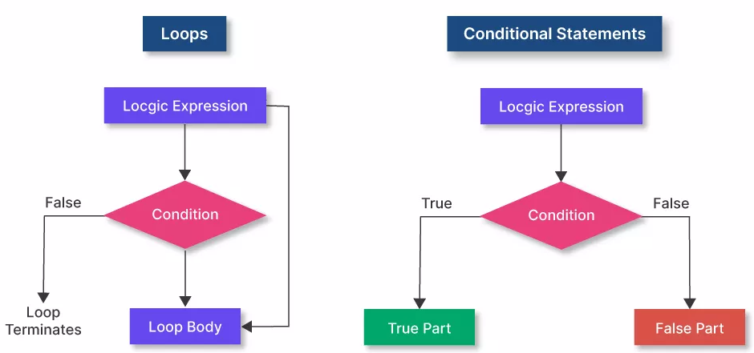
JavaScript Basics
Conditionals
Loops
Used to execute code based on conditions.
  Example:
  let score = 85;
  if (score >= 90) {
  console.log('A grade');
  } else if (score >= 75) {
  console.log('B grade');
  } else {
  console.log('C grade');
  }
Also: switch statements for multiple cases.
Do you know how to write single line if conditions?
Repeat code blocks until a condition is met.
  for (let i = 0; i < 5; i++) {
  console.log('Count:', i);
  }
  let j = 0;
  while (j < 3) {
  console.log('Hello');
  j++;
  }

Slide 6
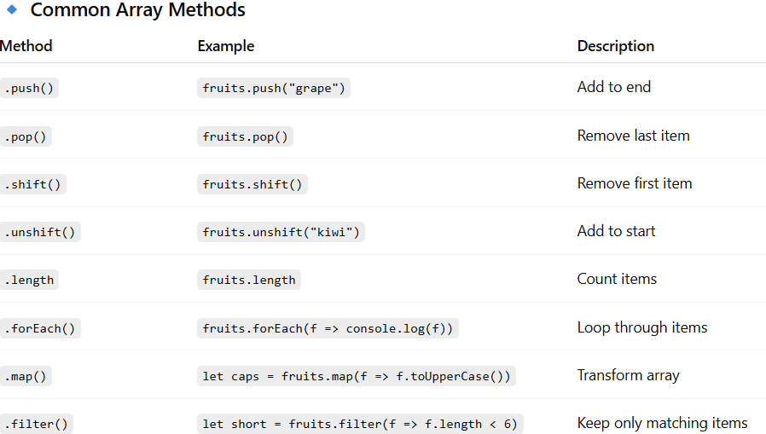
Arrays
JavaScript Basics
Objects
Store key–value pairs to represent structured data.
let person = { name: 'Alice', age: 25, city: 'London' };
Access via person.name or person['age'].
Add or modify: person.country = 'UK';
Loop: for (let key in person) { console.log(key, person[key]); }
Use Arrays for lists; Objects for grouped properties.
Example: let students = [ {name:'John', grade:90}, {name:'Sara', grade:85} ];
Ordered lists of items accessed by index (start from 0).
let fruits = ['apple', 'banana', 'cherry'];

Slide 7
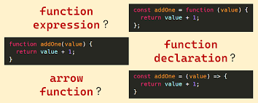
Functions Theory
Functions are reusable blocks of code that perform specific tasks. They help make programs modular, readable, and maintainable.
Declaration forms:
  function declaration: Allows function hoisting (using before declaration)
  function expression: assigned to variables, not hoisted.
  arrow functions: short syntax, no own 'this', ideal for callbacks
Scope determines where are variables seen and who has access to modify them: local vs global.
  Local Scope – variables inside a function are private to it
  Global Scope – accessible everywhere (avoid polluting global namespace by minimizing the usage of global scope as much as possible)
Closures: functions remember variables from their creation scope even after it ends.
  Has a private memory stack for every instance call for a function.
Pure functions :
  Always return the same output for the same input.
  Have no side effects (don’t modify external state).
  Easier to test, debug, and reason about.

Slide 8
Functions Example
JS (snippets):
// declaration
function add(a, b) { return a + b; }
// expression
const sub = function(a, b) { return a - b; };
// arrow
const mul = (a, b) => a * b;
Closure example:
function counter() { let c = 0; return () => ++c; }
const next = counter(); console.log(next()); // 1

Slide 9
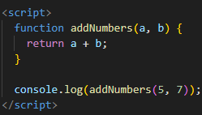
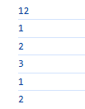
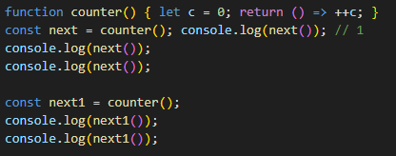
Functions Example
Can you explain why the output is like this?

Slide 10
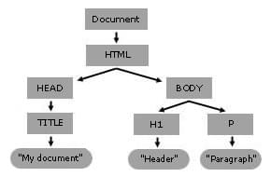
DOM Theory
The Document Object Model (DOM) is the browser's in-memory representation of an HTML document.
The DOM is a tree of nodes: document -> element nodes -> text nodes.
You can read and modify nodes via JavaScript (properties, attributes, methods).
Common APIs: document.getElementById, querySelector, createElement, appendChild, textContent, innerHTML.

Slide 11
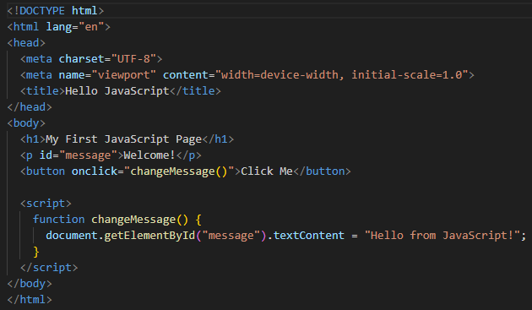
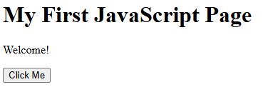
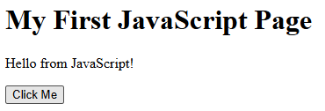
Onclick attribute – provide JS Function to run
Document Object -> P Object -> Text Key changed value from Welcome! To Hello from JavaScript

Slide 12
DOM Example: Access & Update – Predict Code Output
HTML (snippet inside <body> tag):
<p id='greeting'>Welcome</p>
<button id='sayHi'>Say Hi</button>
JS (snippet inside <script>):
const btn = document.getElementById('sayHi');
btn.addEventListener('click', () => {
document.getElementById('greeting').textContent = 'Hello from JS!';
});
Explanation: getElementById returns a node; textContent changes visible text without parsing HTML.
Notice the use of EventListener instead of onclick attribute (We will discuss this further)

Slide 13
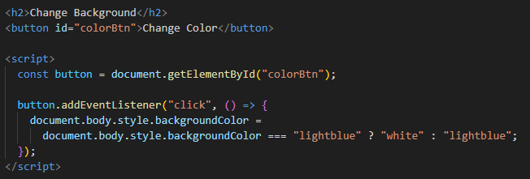



CSS Styling in JS
As any object in the DOM model, <style> can be modified in JavaScript by accessing the required style attribute.
The Inline If condition works as follows $→$Condition Check ? True output : False Output ;

Slide 14
DOM Example: Create Elements – Predict Code Output
JS (snippet):
const list = document.getElementById('todo');
const li = document.createElement('li');
li.textContent = 'New item';
list.appendChild(li);
Explanation: createElement + appendChild adds new nodes without rebuilding the page.
Note that JS can add HTML elements to your webpage based on the logic found in the JS code without you writing the HTML Tags etc..

Slide 15

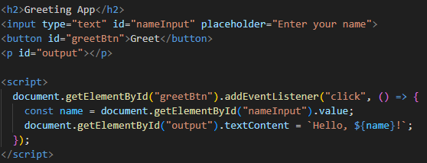
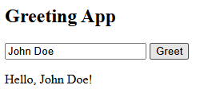
User Inputs and Template Literals
We first accessed the value inside the object input with ID=nameInput.
Notice how the const name is used in the <p> output (Template Literals allow for having placeholders in the code that are later filled by the actual value based on the interaction with the user)

Slide 16
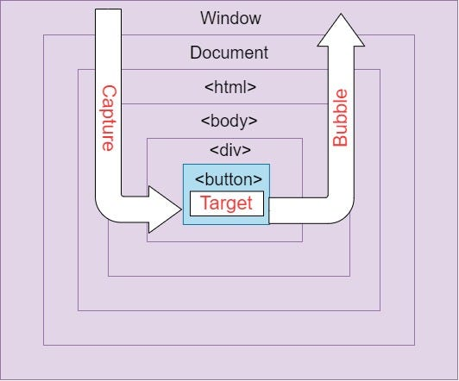
Events Theory
Events represent user or browser actions: click, input, keydown, submit, load, etc.
Two important concepts: event listener registration and event propagation (capturing/bubbling).
Use addEventListener for adding handlers; avoid inline handlers (ex:onclick) for separation of concerns between HTML and JS.
Event object provides details: event.target, event.currentTarget, event.preventDefault(), event.stopPropagation(). Event is passed to routine that was listening to the event.

Slide 17
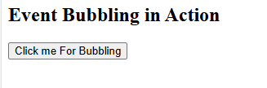
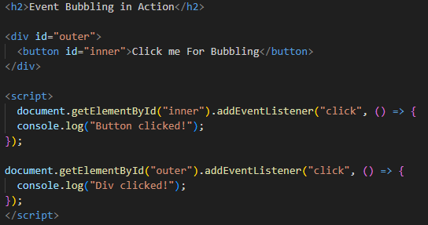
Event Propagation – Bubbling

Slide 18
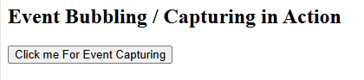
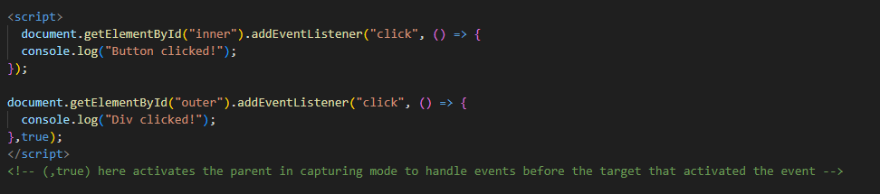
Event Propagation – Capturing
Notice how the code on line 96 is avtivated first before the code on line 92 !!
addEventListener(event type, Listener Routine, Use Capture)
The default mode is bubbling. Only use capturing when you want the parent to handle the event (ex: Delegation)

Slide 19
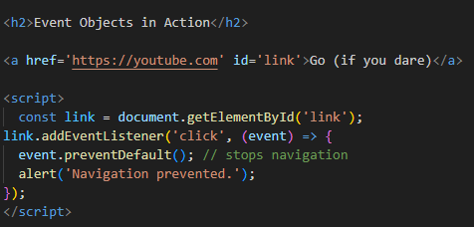

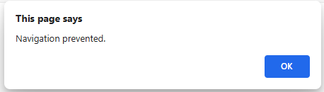
Events Example: Click & preventDefault
Explanation: preventDefault cancels default browser action for that event.

Slide 20
Common Event Objects Properties
Property | Description | Example
e.type | The type of event | "click", "input", "keydown"
e.target | The element that triggered the event | If you click a <button> inside a <div>, then event.target → <button>
e.currentTarget | The element the listener is attached to | If you click a <button> inside a <div>, and listen in <div>, then event.currentTarget → <div>
e.clientX, e.clientY | Mouse position (for mouse events) | 120, 350
e.key | Key pressed (for keyboard events) | "Enter", "a"
e.preventDefault() | Stops the default browser action | e.g., stops a link from navigating
e.stopPropagation() | Stops the event from bubbling | useful for nested elements

Slide 21
Events Example: Delegation – Predict Code Output
Use delegation to attach one handler to a parent instead of many children.
HTML (snippet)
<ul id="list">
<li>Apple</li>
<li>Banana</li>
<li>Cherry</li>
<li>Orange</li>
<li>Grapes</li>
</ul>
JS (snippet):
document.getElementById('list').addEventListener('click', (e) => {
if (e.target && e.target.nodeName === 'LI') {
console.log('Clicked item:', e.target.textContent);
} });

Slide 22
Best Practices & Debugging
Use addEventListener instead of inline handlers; remove listeners when not needed.
Prefer textContent over innerHTML unless you need HTML parsing.
Use console.log and browser devtools (Elements, Console, Network, Performance).
Keep functions small and testable; use descriptive names and comments.

Slide 23
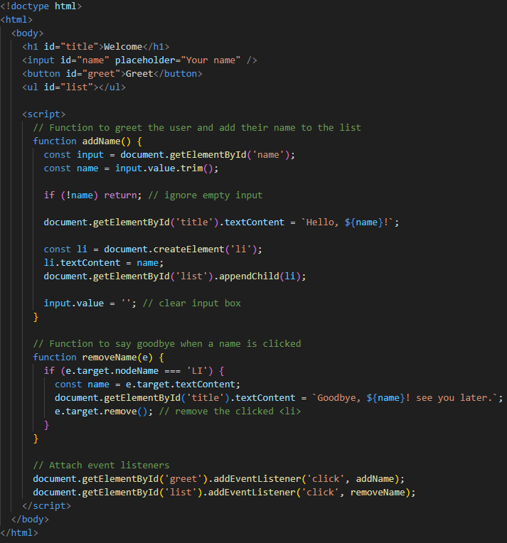
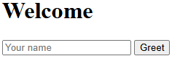
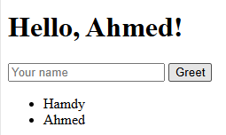
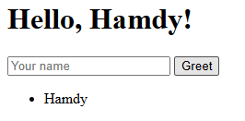
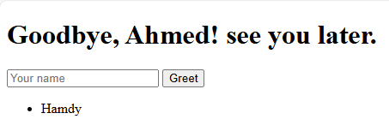
List Example: Reservations

Slide 24
Lab Demo

Slide 25
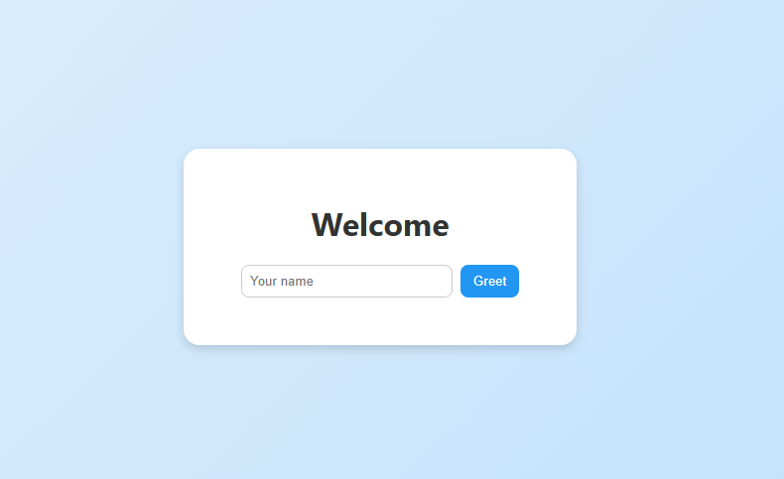
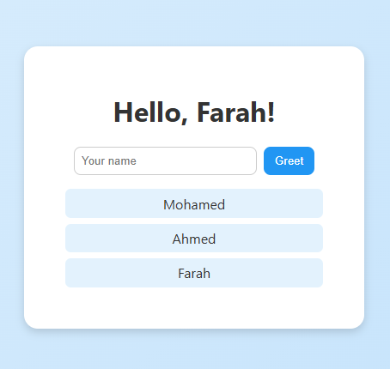
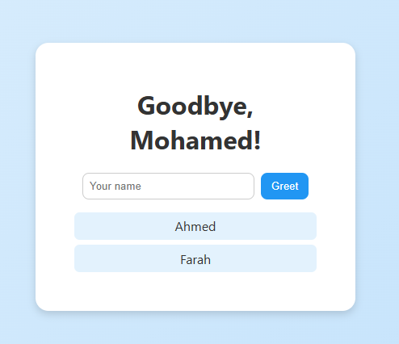

Slide 26
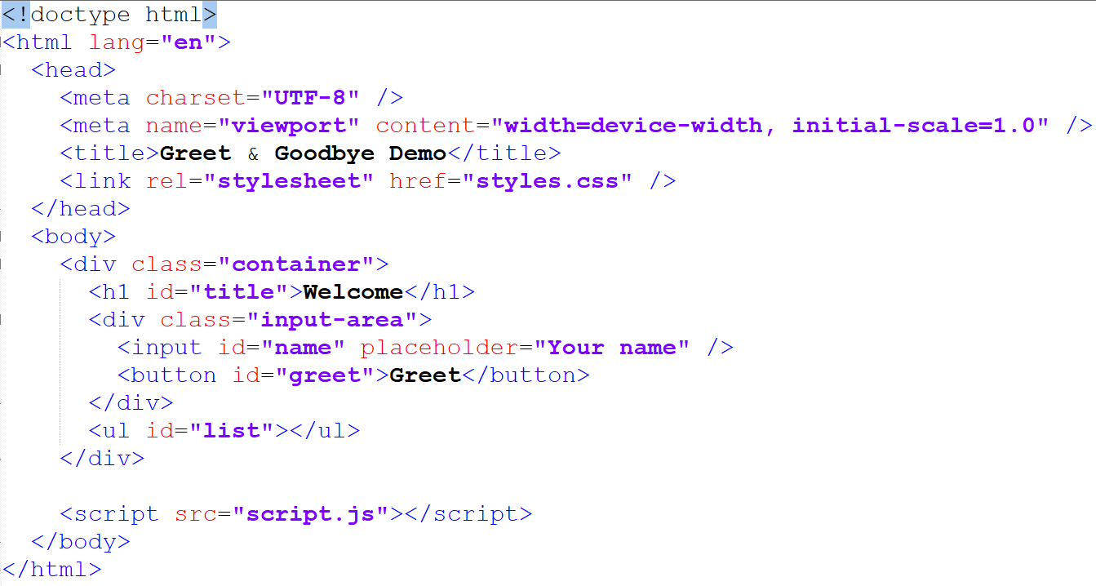
External CSS as seen in last lab
Path to External JS Script added in src attribute for <script>

Slide 27
Lab Task

Slide 28
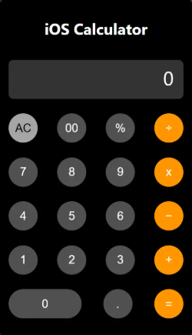
My Interactive Calculator Webpage
Prepare the .HTML File, .CSS File, and .JS file to make a webpage calculator for basic mathematical operations.
Be creative in CSS and Efficient in JS, HTML.
Hints: Break tasks into DOM (select nodes), Event (listen), Logic (functions).

